Slide 1
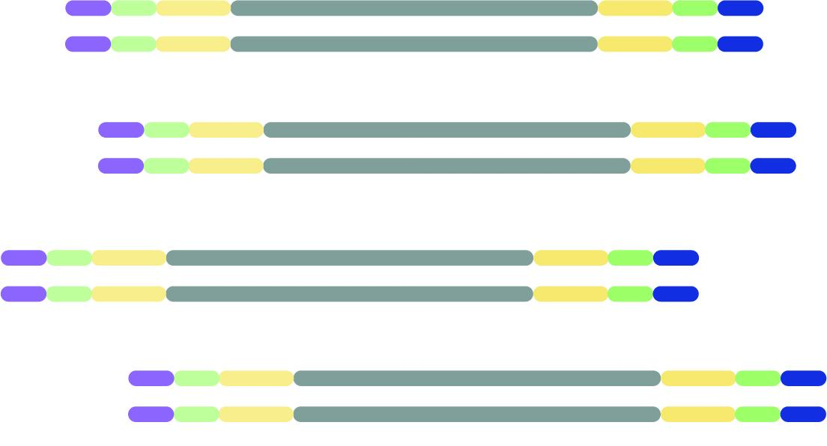
RNA and DNA library prep for mNGS
Rapid Response – Revised 01/12/2026

Slide 2
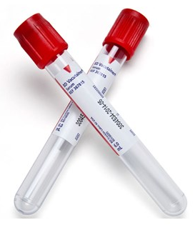
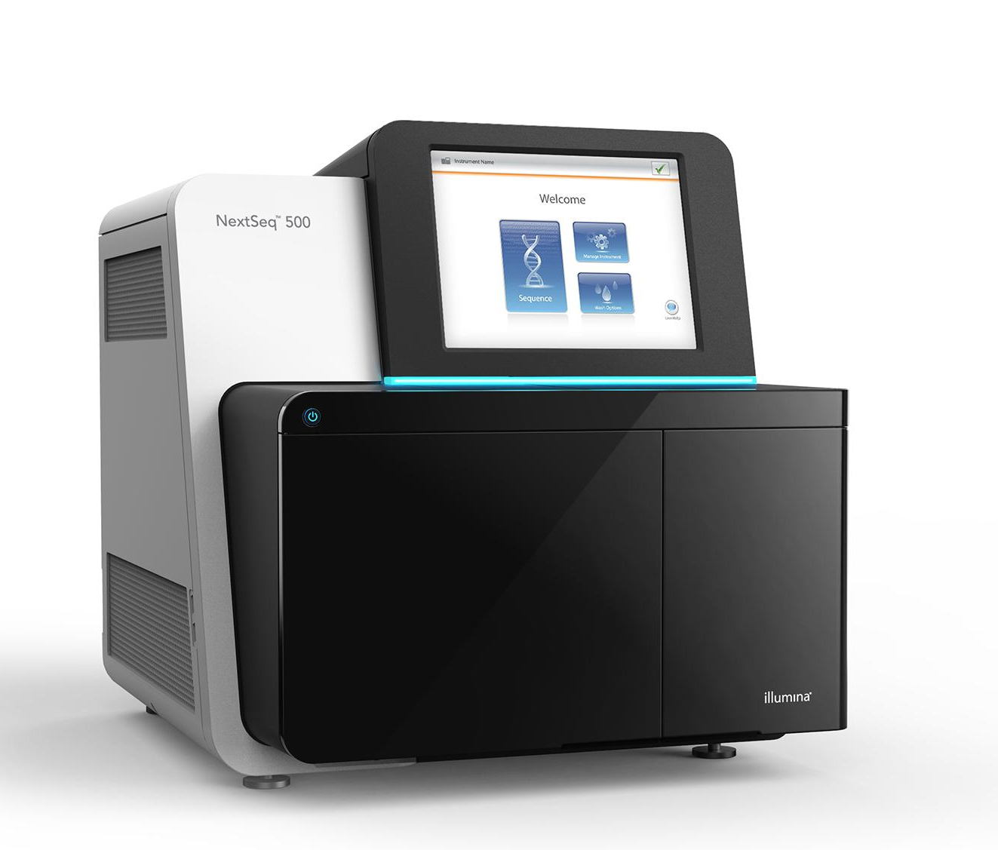
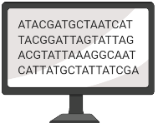
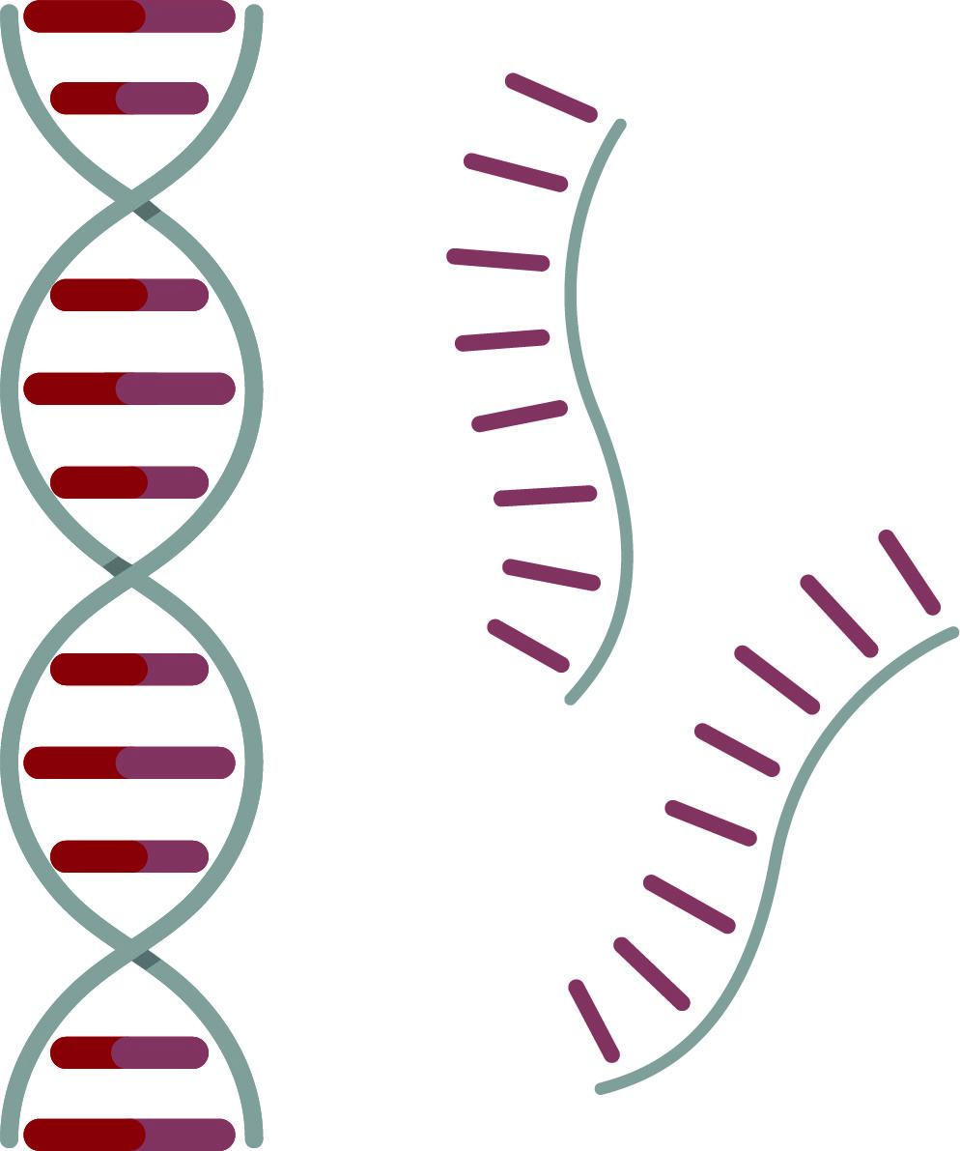


mNGS pipeline
Study design
xNA extraction
Library prep
Sequencing
Data analysis
Pathogen ID
Type(s)
Controls
Storage
Lab setup
Type(s)
Controls
QC
Host removal
Fragmentation
dsDNA generation
End-repair
Adapter ligation
Barcoding & PCR
Clean-up
Pooling
QC
Machine
Read length
Loading conc.
QC data
Host removal
Alignment
Blast
Ranking of hits

Slide 3
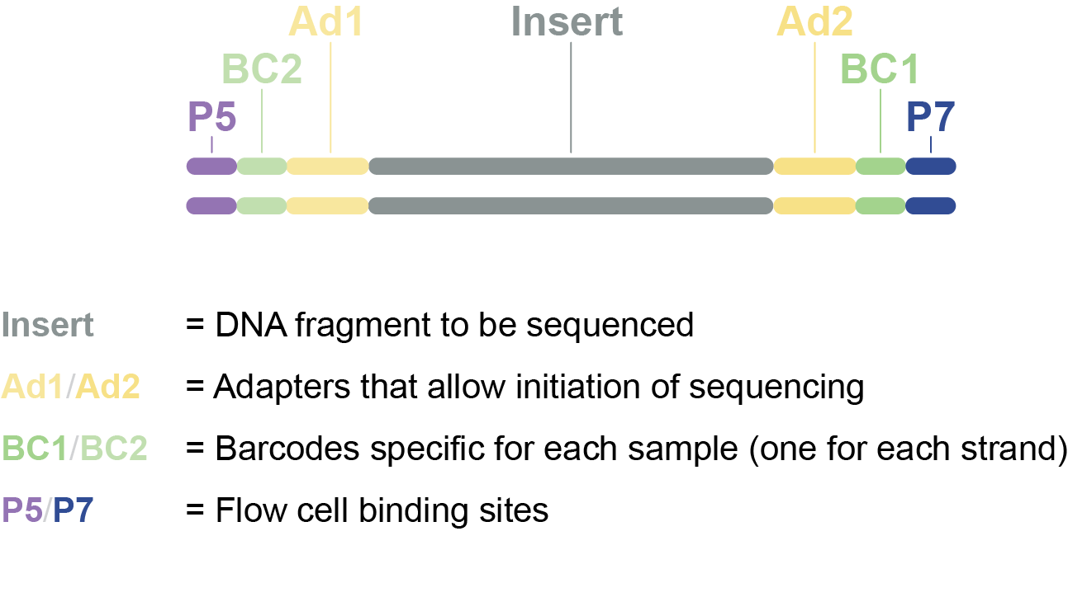
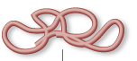
Library prep: RNA to sequencing library
Sequencing library = Pool of DNA inserts with sequencing adapters attached
Extracted RNA
Sequencing library

Slide 4
Steps in library preparation:
1. Host depletion, RNA fragmentation + priming
2. First strand cDNA synthesis
3. Second strand cDNA synthesis
4. End Prep
5. Adapter Ligation
6.. USER + Barcoding PCR

Slide 5
Library prep
Sequencing library = Pool of DNA inserts with sequencing adapters attached

Slide 6
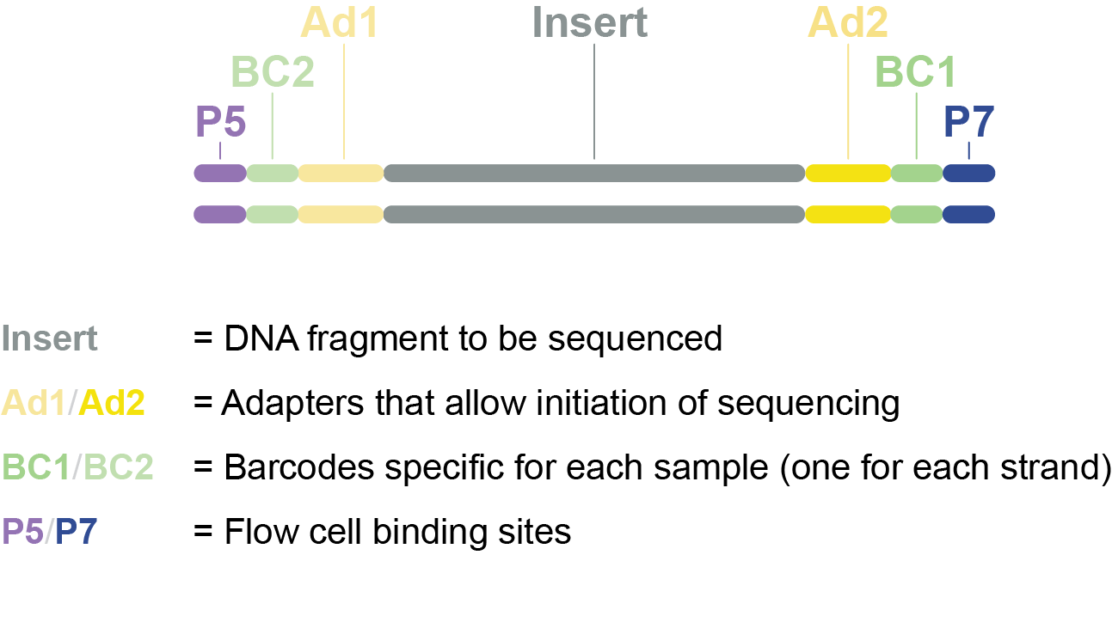
Library prep
Sequencing process:
F
L
O
W
C
E
L
L
F
L
O
W
C
E
L
L
Read 1
Read 2
Notes:
Animation shows how your library is sequenced.

Slide 7
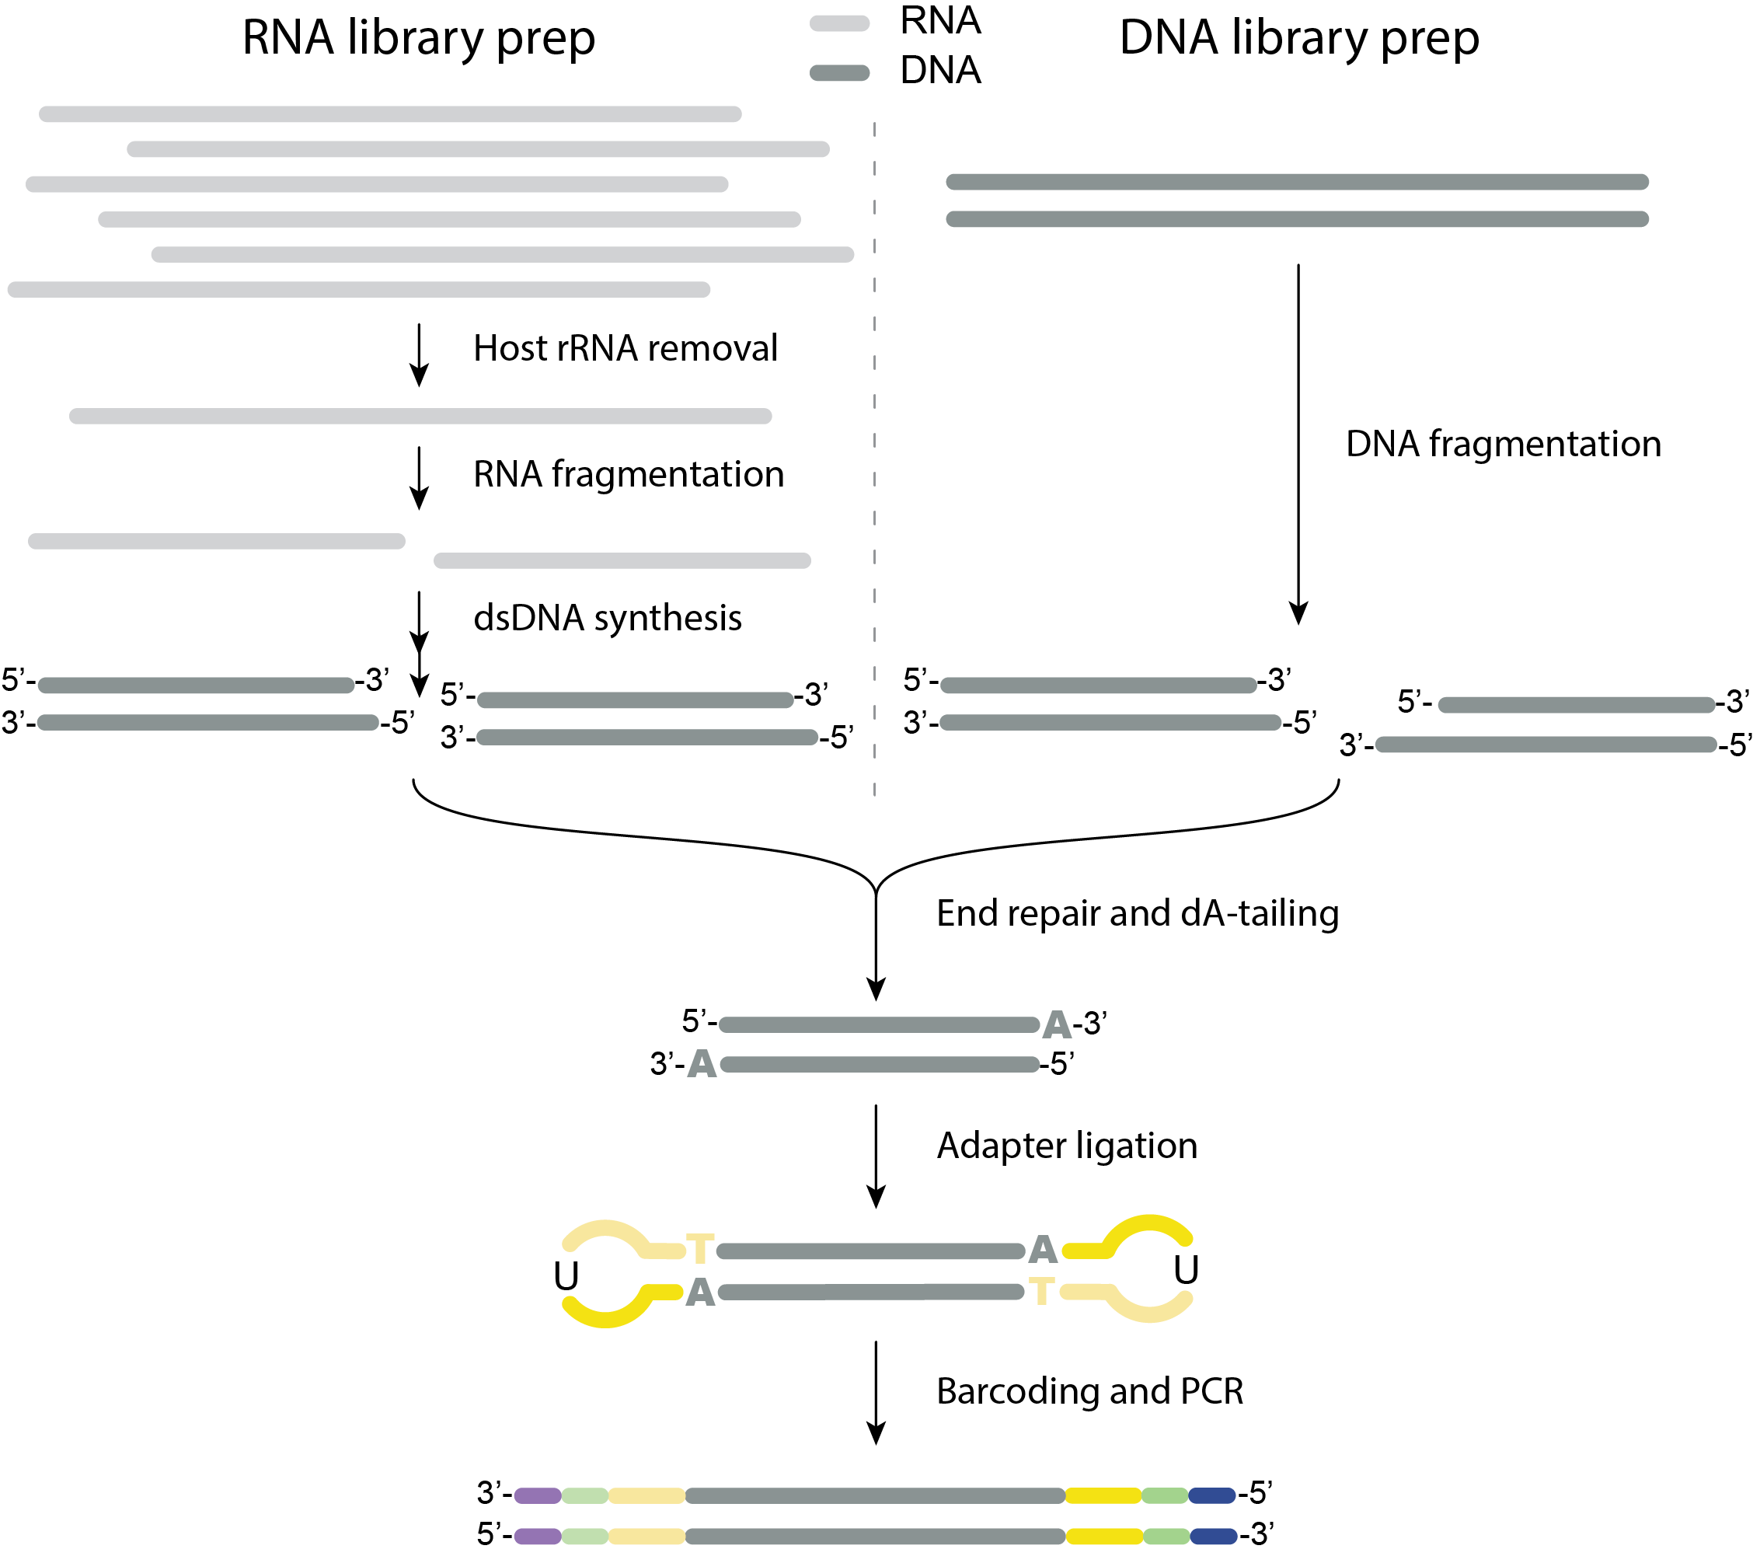
Library prep
RNA or DNA library
Notes:
RNA and DNA library prep steps. We’ll go into detail of RNA library prep since that is the more complicated one. And once you are familiar with RNA library prep, you’ll find DNA library prep to very similar but simpler.

Slide 8
RNA library prep
STEP 0. Starting material: RNA or TNA
RNA only: move on to host rRNA depletion
TNA (total nucleic acid): need to remove DNA
Aliquot sample
DNAse I treatment
SPRI bead clean-up (2x)
Qubit quantification
Notes:
If you extract RNA you can proceed to the next step. But if you extracted total nucleic acid, you’ll have to remove the DNA first. This can be achieved by DNAse I treatment

Slide 9
RNA library prep
RNA content of typical host sample
95% host rRNA
2-3% host mRNA
1% other host RNA
<1% pathogen RNA
STEP 1. Host rRNA depletion
Before RNA extraction:
Serum or plasma instead of blood
Supernatant of CSF to remove WBCs
Human RNA depletion kits to use after RNA extraction:
TruSeq Stranded total RNA Human (previously Ribo-Zero, Illumina)
Biotinylated, target-specific oligos + Ribo-Zero beads to fish out rRNA
FastSelect (Qiagen): $150 for 24 samples when reagent is diluted 1:10
Proprietary technology, presumably with hybridizing probes that make rRNA inaccessible to enzymes in subsequent steps
Preferred
(no extra wash required)
Notes:
Next step involves removing as much human host material as possible. The RNA content of a typical host sample will be 95% host rRNA, 2-3% host mRNA and 1% other host RNA. And then less than 1% usually is pathogen RNA. If you prepare a sequencing library from such a sample, all of these types of RNA would be sequenced, and only 1% of your reads would be from pathogens that you are interested in. So it’s important to first remove host rRNA as much as possible, to allow your pathogens take up more of the sequencing data.
FastSelect takes host rRNA from 95% to about 30% in our hands

Slide 10
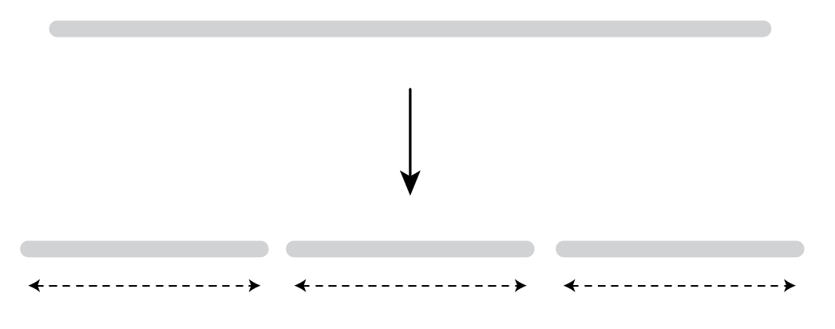
RNA library prep
STEP 2. Fragmentation
Ideal insert size = ± 400 nt
Several ways to fragment RNA:
Enzymatic: %GC-dependent -> may bias mNGS results
Heat cycling: relatively random
Sonication: larger volume required, expensive machine, contamination risk
Divalent cations: allow RNA to be self-cleaving (Mg²⁺, Ca²⁺, Zn²⁺, …)
Mg²⁺ and heat (94ºC) for 2-15 minutes depending on RNA quality
High quality RNA: long fragmentation time
Low quality RNA: short fragmentation time
Fragmentation
± 400 nt
± 400 nt
± 400 nt
NEBNext Ultra ii RNA library kit
Notes:
FastSelect takes host rRNA from 95% to about 30% in our hands

Slide 11
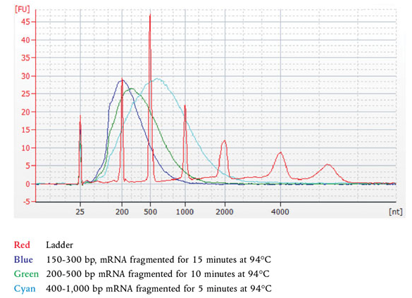
RNA library prep
Fragmentation pattern of high quality RNA
STEP 2. Fragmentation
Use shorter fragmentation times when RNA quality is compromised!
Notes:
From NEBNext Ultra II RNA First Strand Synthesis Module E7771 manual

Slide 12
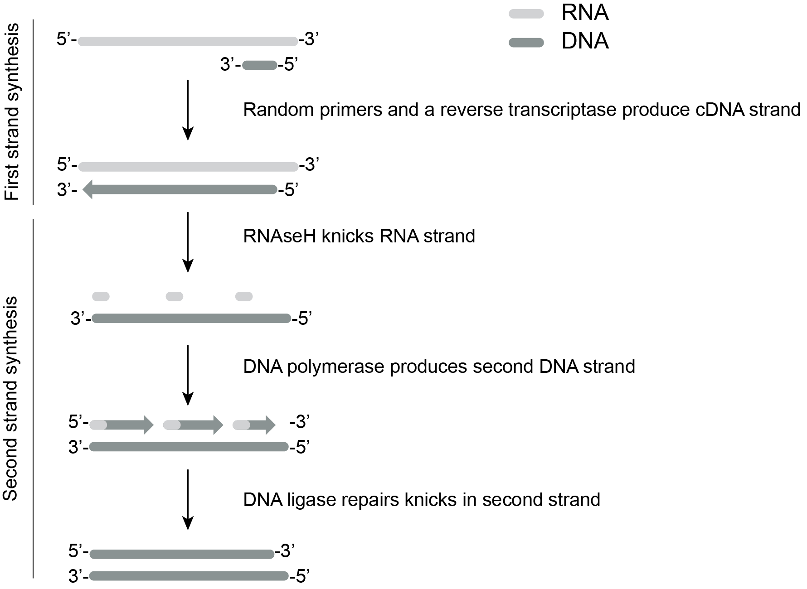
RNA library prep
STEP 3. dsDNA synthesis
First strand synthesis
Second strand synthesis
Purify dsDNA by SPRI bead clean-up (1.8x)

Slide 13
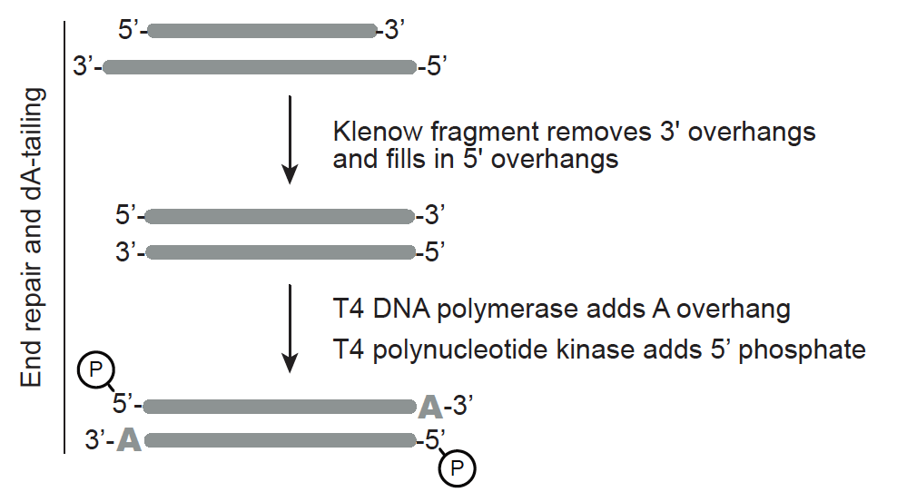
RNA library prep
STEP 4. End repair & dA-tailing
Remove overhangs to get blunt ends
Prep fragment to clone on adapters
Add 5’ phosphate (T4 kinase)
Add single 3’ A overhang to clone on adapters
(T4 DNA polymerase)
Note: After end-repair, move on to adapter ligation step ASAP
(5’ phosphate is fragile)

Slide 14
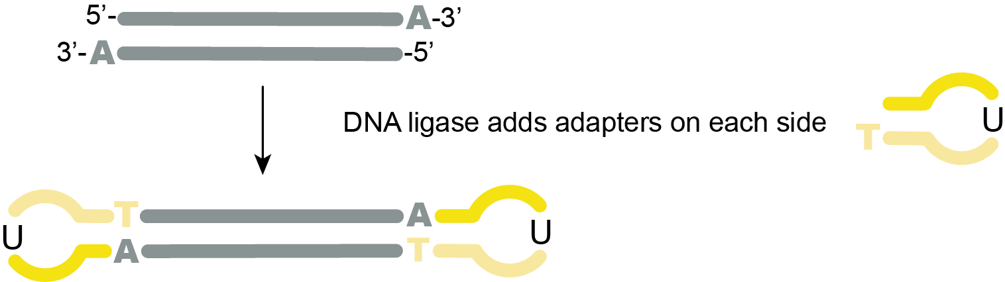

RNA library prep
STEP 5. Adapter ligation
Adapters are added to allow sequencing
Remove adapter dimers by SPRI bead clean-up (0.9x)
Adapter dimers are our enemy #1 after this step (short fragments get preferentially sequenced)

Slide 15
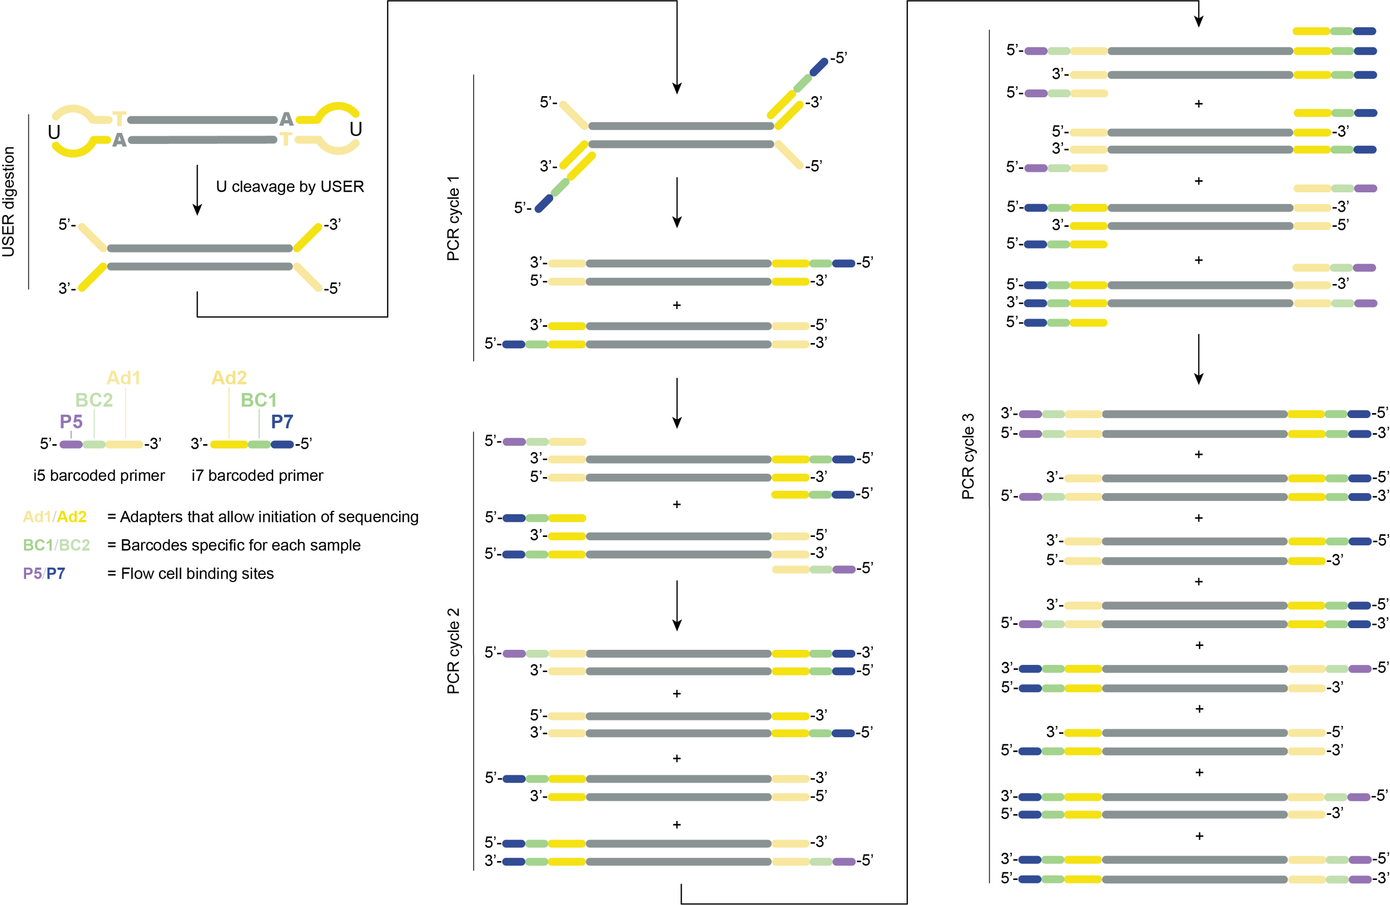
RNA library prep
STEP 6.
USER digestion & barcoding PCR
USER enzyme opens up adapters
i5 and i7 oligos are added by PCR
SPRI bead clean-up (0.8x)
...
Notes:
Reduce #PCR cycles to the absolute minimum to avoid amplification bias.

Slide 16
RNA library prep
Final library for one sample

Slide 17
RNA library prep
How to prepare
a library in the lab?

Slide 18
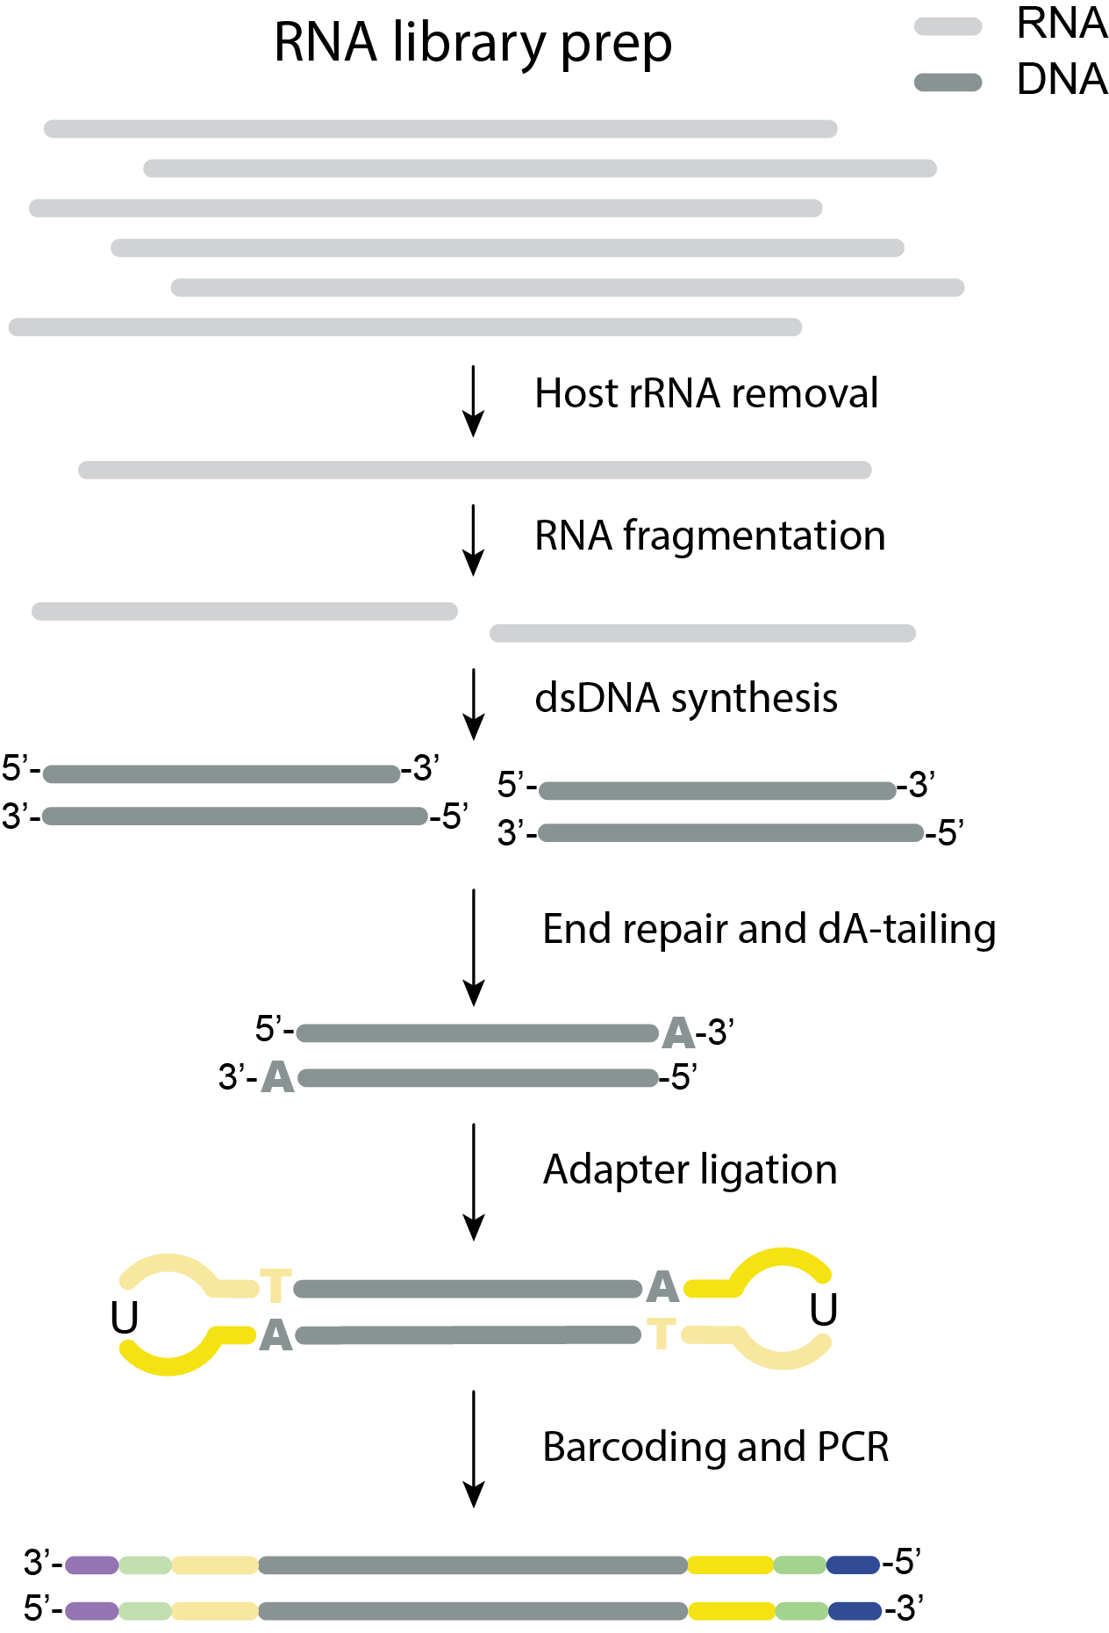
RNA library kit options
NEBNext
Ultra II RNA
Illumina
TruSeq
Illumina
Nextera
1 rxn,
fragm. by Mg²⁺ & heat
1 rxn,
fragm. by Mg²⁺ & heat
cDNA made separately
1 rxn for 1st str. synt.
1 rxn for 2nd str. synt.
1 rxn for 1st str. synt.
1 rxn for 2nd str. synt.
1 rxn,
Transposome frag. and ligation of adapters
1 rxn
1 rxn
1 rxn, U shaped adapters
1 rxn, Y shaped adapters
1 rxn
1 rxn
1 rxn
Notes:
We’ll use the NEBNextUltra II RNA kit as an example

Slide 19
RNA library prep (NEBnext Ultra II RNA)
All in pre-PCR lab
RNA fragmentation, priming and host rRNA removal
Prepare mix
Time depends on RNA quality!
2. Thermocycler:
2-8 min at 94ºC: fragmentation
2 min at 75ºC
2 min at 70ºC
2 min at 65ºC
2 min at 60ºC
2 min at 55ºC
5 min at 37ºC
5 min at 25ºC
Hold at 4ºC
Reagents | μl per reaction
RNA sample (10ng – 100ng total) | 4
First Strand Synthesis Reaction Buffer (5x) | 4
Random Primers | 1
*QIAseq FastSelect (1:100) rRNA | 1
Total volume | 10
Slow ramp for FastSelect to specifically anneal to host rRNA
Notes:
Removed ERCCs here

Slide 20
RNA library prep
All in pre-PCR lab
B. First Strand Synthesis
Prepare mix
2. Thermocycler:
10 min at 25ºC: random primer annealing
15 min at 42ºC: reverse transcription rxn
15 min at 70ºC: heat inactivation of enzymes
Hold at 4ºC
Reagents | μl per reaction
Fragmented and primed RNA | 10
Nuclease-free water | 8
NEBNext First Strand Synthesis Enzyme Mix | 2
Total volume | 20
Notes:
Random primers are about 5 bp long, so low annealing temperature of 25C

Slide 21
RNA library prep
All in pre-PCR lab
C. Second Strand Synthesis
Prepare mix
2. Thermocycler (HEATED LID OFF):
1 hr at 16ºC: 2nd strand synthesis
Hold at 4ºC
Reagents | μl per reaction
First strand synthesized DNA | 20
2nd Strand Synthesis Reaction Buffer (10x) | 8
2nd Strand Synthesis Enzyme Mix | 4
Nuclease-free water | 48
Total volume | 80
3. SPRI bead cleanup (1.8x) to purify dsDNA
Notes:
RNAseH knicks RNA strand
DNA polymerase produces second strand
DNA ligase fills up the gaps

Slide 22
RNA library prep
All in pre-PCR lab
D. End prep of cDNA
Prepare mix
2. Thermocycler (heated lid at 105ºC):
30 min at 20ºC:
Klenow fragment creates blunt ends
T4 kinase adds 5’ phosphate,
T4 DNA polymerase adds 3’ A overhang
30 min at 65ºC: heat inactivation of enzymes
Hold at 4ºC
Reagents | μl per reaction
Purified dsDNA | 50
Ultra II End Prep Reaction Buffer (8.6x) | 7
Ultra II End Prep Enzyme Mix | 3
Total volume | 60
3. Proceed immediately to next step, do NOT freeze.
Notes:
Enzymes: Klenow fragment to get blunt ends
T4 polynucleotide kinase to add 5’ phosphate
T4 DNA polymerase to add 3’ A overhang

Slide 23
RNA library prep
All in pre-PCR lab
E. Adapter ligation
Prepare mix
2. Thermocycler (HEATED LID OFF):
15 min at 20ºC
Reagents | μl per reaction
End prep reaction mixture | 60
NEBNext Ultra II Ligation Master Mix | 30
NEBNext Ligation Enhancer | 1
1:10 Adapters (only add at the very end, do not pre-mix) | 2.5
Total volume | 93.5
3. Proceed immediately to SPRI bead cleanup (0.9x)
Notes:
Enhancer: likely DMSO, acts as crowding agent
Add adapters only at the very end to avoid adapter dimers forming in the mix.

Slide 24
RNA library prep
F. USER digestion and Barcoding PCR
Prepare mix
Pre-PCR lab
Post-PCR lab
2. Bring tubes/plate to POST-PCR lab
Reagents | μl per reaction
Purified, adapter-ligated dsDNA | 15
USER Enzyme | 3
NEBNext Ultra II Q5 Master Mix | 25
5 μM i7 barcoded primer | 5
5 μM i5 barcoded primer | 5
Total volume | 53
3. Thermocycler (Heated lid at 105ºC):
15 min at 37ºC: USER enzyme activity
30 sec at 98ºC
10 sec at 98ºC
75 sec at 65ºC
5 min at 65ºC
Hold at 4ºC
6 to 15 cycles
4. SPRI bead cleanup to remove amplified dimers
Notes:
Enhancer: likely DMSO, acts as crowding agent
Add adapters only at the very end to avoid adapter dimers forming in the mix.

Slide 25
NEBNext
Ultra II RNA
Illumina
TruSeq
Illumina
Nextera
1 rxn,
fragm. by Mg²⁺ & heat
1 rxn,
fragm. by Mg²⁺ & heat
cDNA made separately
1 rxn for 1st str. synt.
1 rxn for 2nd str. synt.
1 rxn for 1st str. synt.
1 rxn for 2nd str. synt.
1 rxn,
Transposome frag. and ligation of adapters
1 rxn
1 rxn
1 rxn, U shaped adapters
1 rxn, Y shaped adapters
1 rxn
1 rxn
1 rxn

Slide 26
DNA library prep
DNA library kit options
gDNA or cDNA
NEBNext
Ultra II FS DNA
Illumina
DNA Prep
WGS, cDNA, amplicons
Illumina
Nextera XT
(small genomes, cDNA, amplicons)
Fragmentation
1 rxn,
Transposome frag. + ligation on bead
1 rxn,
Transposome frag. + ligation in solution
1 rxn,
Fragm. enzyme + repair enzymes
1 rxn, U shaped adapters
1 rxn
1 rxn
1 rxn
Notes:
DNA library prep follows the same steps as RNA library prep, except that the RT step is not required and that fragmentation happens enzymatically or by a transposome (instead of Mg2+ and heat for RNA library prep)

Slide 27
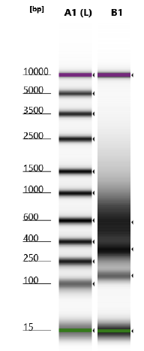
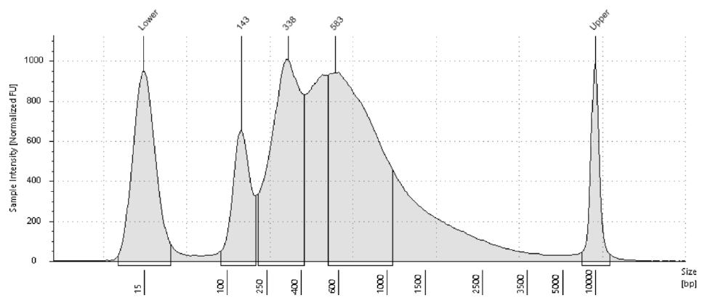
Library prep QC
Library QC: quantity & quality
Quantity (ng/μl): Qubit to determine concentration of individual libraries (0.5-10 ng/μl)
Quality (bp): Tapestation to determine (i) length of library and (ii) degree of dimers present
Post-PCR lab
Dimers
Library
Library (250-1000 bp)
Dimers (143 bp)

Slide 28
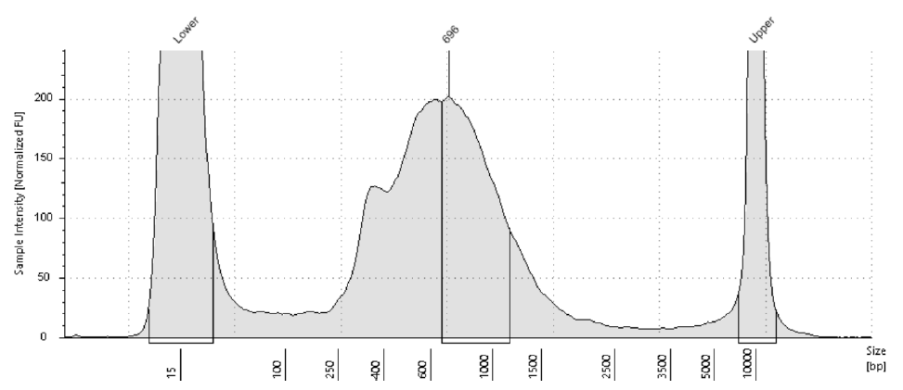
Library prep QC
Library QC: quantity & quality
Quantity (ng/μl): Qubit to determine concentration of individual libraries (0.5-10 ng/μl)
Quality (bp): Tapestation to determine (i) length of library and (ii) degree of dimers present
Post-PCR lab
Size selection by SPRI beads
to remove dimers
After PCR amplification
After SPRI bead clean-up
3 rounds
SPRI (0.85x)
Adapter dimers
ALL DIMERS SHOULD BE REMOVED!
Notes:
Adapter dimers are short fragments and since short fragments are preferentially sequenced, even a relatively small amount of adapter dimers in your library will cause adapter sequences to take up a large proportion of your sequencing data. Avoid this waste of sequencing data by removing all adapter dimers from your library prior to loading the sequencer!
If no tapestation then do diagnostic PCR: take 1 ul library and use Illumina universal primers to PCR (35-40 cycles) and run on a gel. If dimers seen -> SPRI more
Tapestation and QPCR for quantification: ideal size is 550 nt, but anything between 200-1000 is ok.

Slide 29
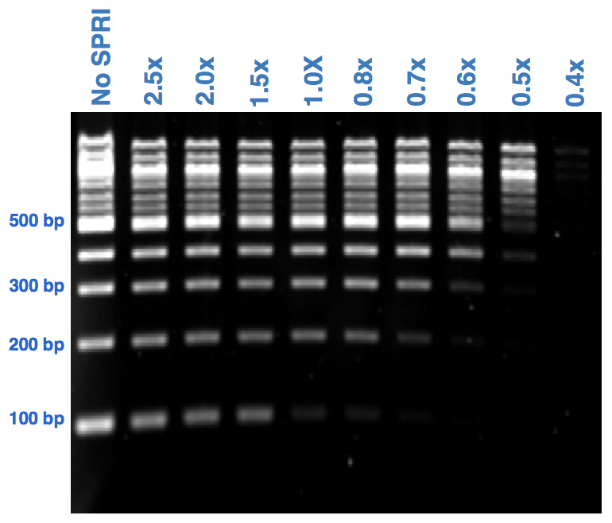
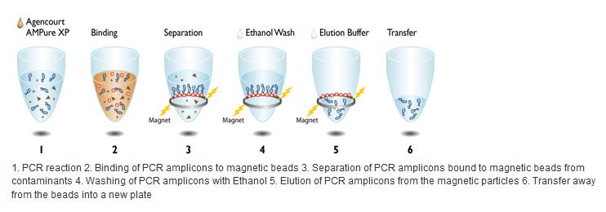
Library prep QC
AMPure XP SPRI select beads (paramagnetic)
or homemade SPRI beads (>10x cheaper)
The longer a fragment, the better it will bind to the beads
The fewer beads you add, the more short fragments you’ll lose
Perform size selection using SPRI beads to remove adapter dimers (143 bp)
Volume beads
Volume reaction
SPRI ratio =
Example: for a 1.8x SPRI clean-up:
Add 18 μl of SPRI beads to 10 μl of sample
Notes:
Buffer is PEG (crowding), NaCl (precipitation), Tween (reduce plastic stickiness) and TE buffer.

Slide 30
Library prep QC
SPRI bead clean-ups during library prep
Size selection using SPRI beads to remove adapter dimers
Rule of thumb: dimers should be completely should disappear before
Step | Ideal RNA/library size | To remove | SPRI ratio
After DNAse I treatment | - | Reagents
After second strand synth. | ± 400 bp | Reagents | 1.8x
After adapter ligation | ± 464 bp | Adapter dimers (64 bp) & reagents | 0.9x
After P7/P5 PCR | ± 543 bp | P5-adapter dimer-P7 (143 bp) & reagents | 0.8x
QC of library | ± 543 bp | P5-Adapter dimer-P7 (143 bp) | 0.8x
Notes:
Adapter dimers should be less than 1% of your total library
P7: 24 nt p7 + 12 nt barcode + 2 nt + 32 nt adapter compl.
P5: 20 nt p5 + 9 nt +12 nt barcode + 33 nt adapter compl.

Slide 31
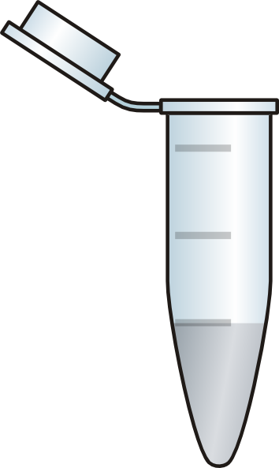
Library prep QC
Pooling samples for sequencing
Each sample has a unique set of barcodes -> multiple samples can be pooled in one sequencing reaction
QCed Sample A
BC2
BC1
QCed
Sample B
BC4
BC3
Final QC & seq prep
Pool
QCed
Water control A
BC6
BC5
Notes:
Every sample has its own set of barcodes, so everything can be pooled.

Slide 32
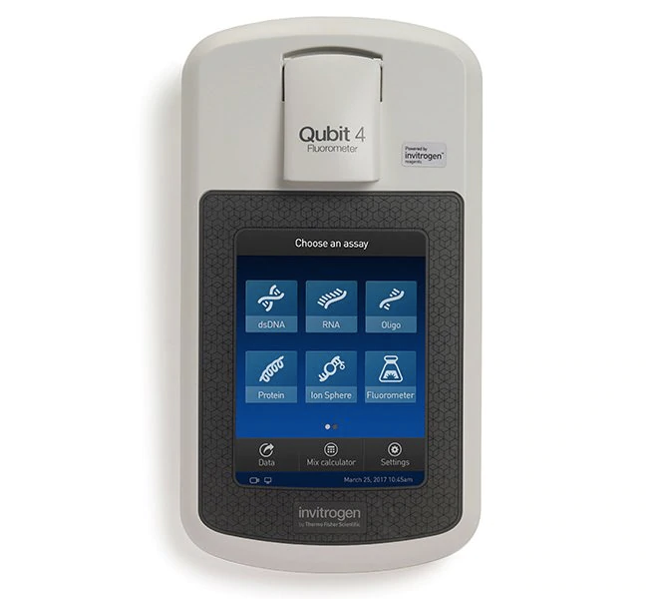
Library prep QC
Pooling samples together for sequencing
Qubit to determine concentration of individual libraries (expect library to be 0.5 to 10 ng/ul)
Pool barcoded libraries so that all are equally represented (except H₂O controls, only 1:5)
Qubit concentration
Pool
Sample 1: 10 ng/ul -> 4.0 μl -> 40 ng
Sample 2: 5 ng/ul -> 8.0 μl -> 40 ng
Sample 3: 8 ng/ul -> 5.0 μl -> 40 ng
Sample 4: 15 ng/ul -> 2.6 μl -> 40 ng
H₂O control: 1 ng/ul -> 8.0 μl -> 8 ng
Total: 27.6 μl
168 ng
End goal is >10 μl of 2 nM pooled library (or 4 nM for MiSeq)
Notes:
10 ng/ul would be a lot for a library -> tone down PCR cycles next time

Slide 33
Library prep QC
Pick one way to calculate nM and stick with it!
Qubit concentration and library size
Automatic calculation by Tapestation
Pooling samples together for sequencing
3. After pooling, determine quantity and quality of pool
Qubit
concentration in ng/μl
Concentration in nM =
x 10⁶
660g/mol x average library size in bp
Capillary or gel electrophoresis
Example: if concentration is 6.1 ng/μl, and average library size is 550 bp -> concentration is 16.8 nM
End goal is >10 μl of 2 nM pooled library

Slide 34
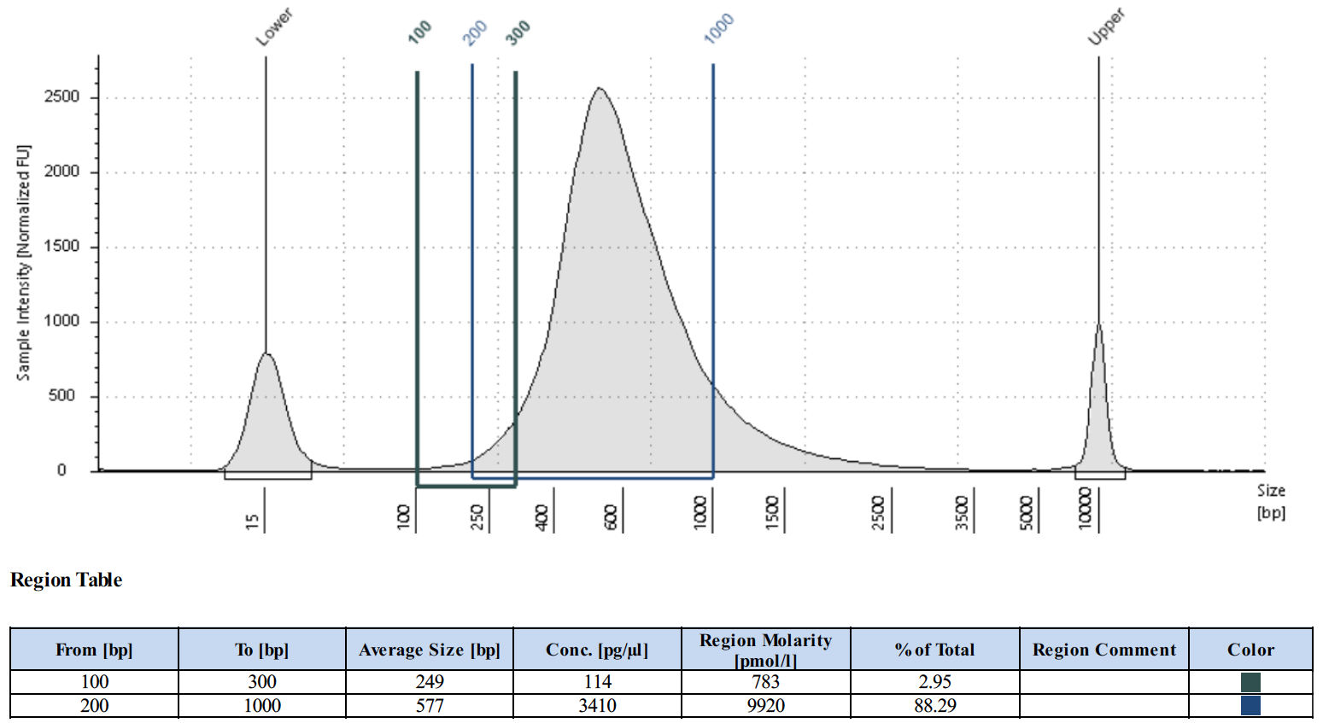
Library prep QC
Pick one way to calculate nM and stick with it!
Qubit concentration and library size
Automatic calculation by Tapestation
Pooling samples together for sequencing
3. After pooling, determine quantity and quality of pool
Or use Tapestation to calculate concentration of library in nM for fragments between 200-1000 bp long
(see extra slides for a step-by-step guide on how to set that up)
200-1000 bp: 9.92 nM

Slide 35
Library prep - preparing to load the sequencer
Dilute library to the correct loading concentration:
iSeq:
dilute to 75 pM (or another optimized concentration),
Spike in 1-5% of PhiX at the same concentration
MiSeq:
First denature library with sodium hydroxide (NaOH)
Then dilute to 10-12 pM (or another optimized concentration)
Spike in 1-5% of denatured PhiX to denatured and diluted library
See slide decks for iSeq or MiSeq loading for more details!

Slide 36
Next step:
iSeq or MiSeq loading

